Slide 1
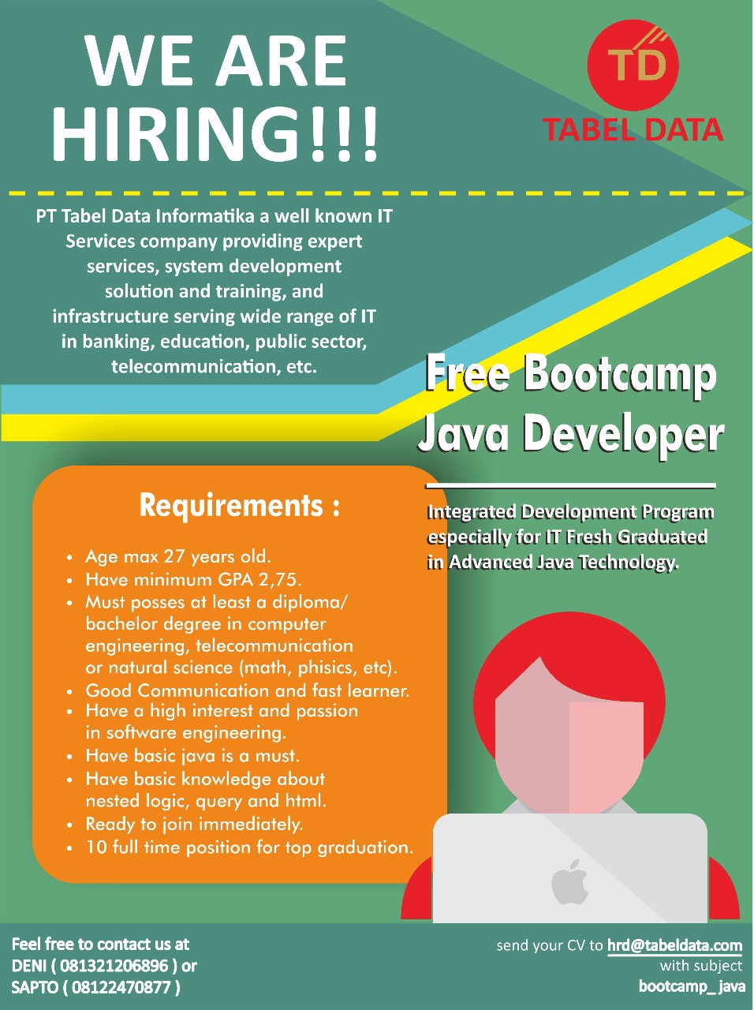
Bootcamp Java Developer #Day 1
PT. Tabel Data Infromatika
By Dimas Maryanto,S.Kom

Slide 2
Java Database Connectivity
JDBC is Java API that can access any kind of tabular data, especially data stored in a Relational Database.

Slide 3
Istilah dalam JDBC
Setup / Konfigurasi
Implementasi
Datasource
DriverManager
Driver
URL JDBC
User
Password
Connection
Statement
PreparedStatement
ResultSet
Transaction
Commit
Rollback

Slide 4
Setup Connection

Slide 5
Statement

Slide 6
ResultSet

Slide 7
PreparedStatement

Slide 8
PreparedStatement & ResultSet

Slide 9
SQL injection

Slide 10
Transactional
Commit
Rollback
Savepoint

